Slide 1
POWER BI

Slide 2
What is Power BI?
Power BI is a business analytics solution that lets you visualize your data and share insights across your organization, or embed them in your app or website. Connect to hundreds of data sources and bring your data to life with live dashboards and reports

Slide 3
Power BI Desktop
Connect securely to hundreds of data sources —in the cloud and on-premises
Transform and mash up data from multiple sources—in just a few clicks
Create, design and distribute Bl content - Extend your data models with DAX formulas
Choose from more than 100 cutting-edge data visuals—or create your own
Dig deep into data to find patterns and discover insights
Create mobile reports for on-the-go users
Publish securely to the web or an on-premises report server, or embed visuals in your website or app

Slide 4
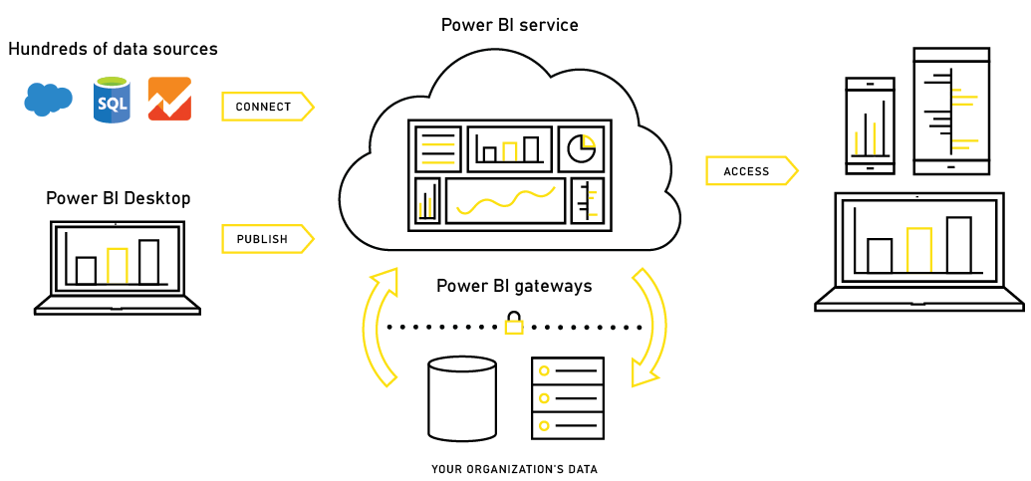
Power BI System Architecture

Slide 5
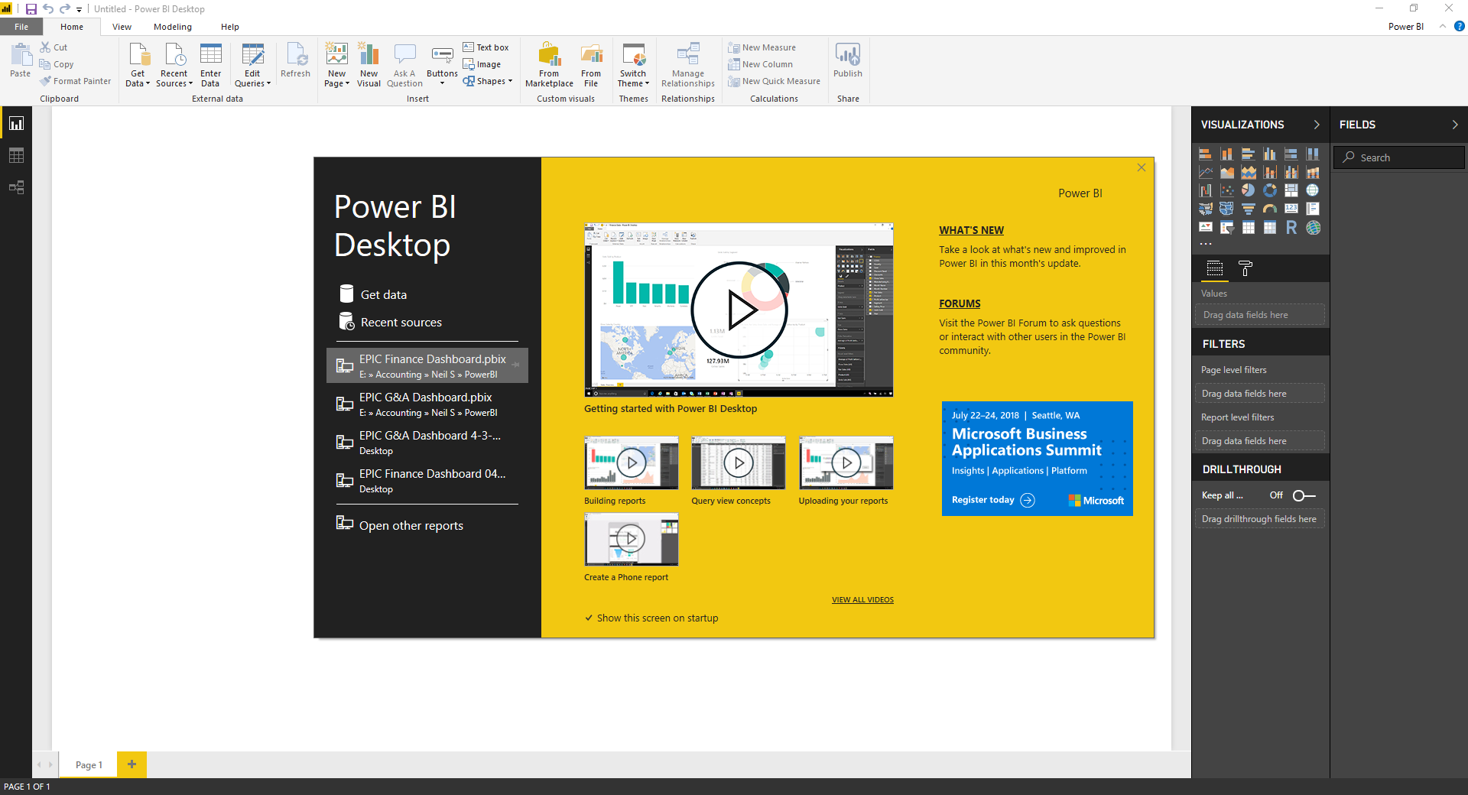
Power BI Desktop – Welcome Splash Screen
When you first open up Power BI it will open on the Splash Screen where you will find a lot of helpful information.
Find out what is new in the latest release or interact on the highly interactive forums, which are a great way to ask questions
Start a new import from a new source, or connect to a recently used source
Tutorial Videos
Open a recent file or other report
Announcements

Slide 6
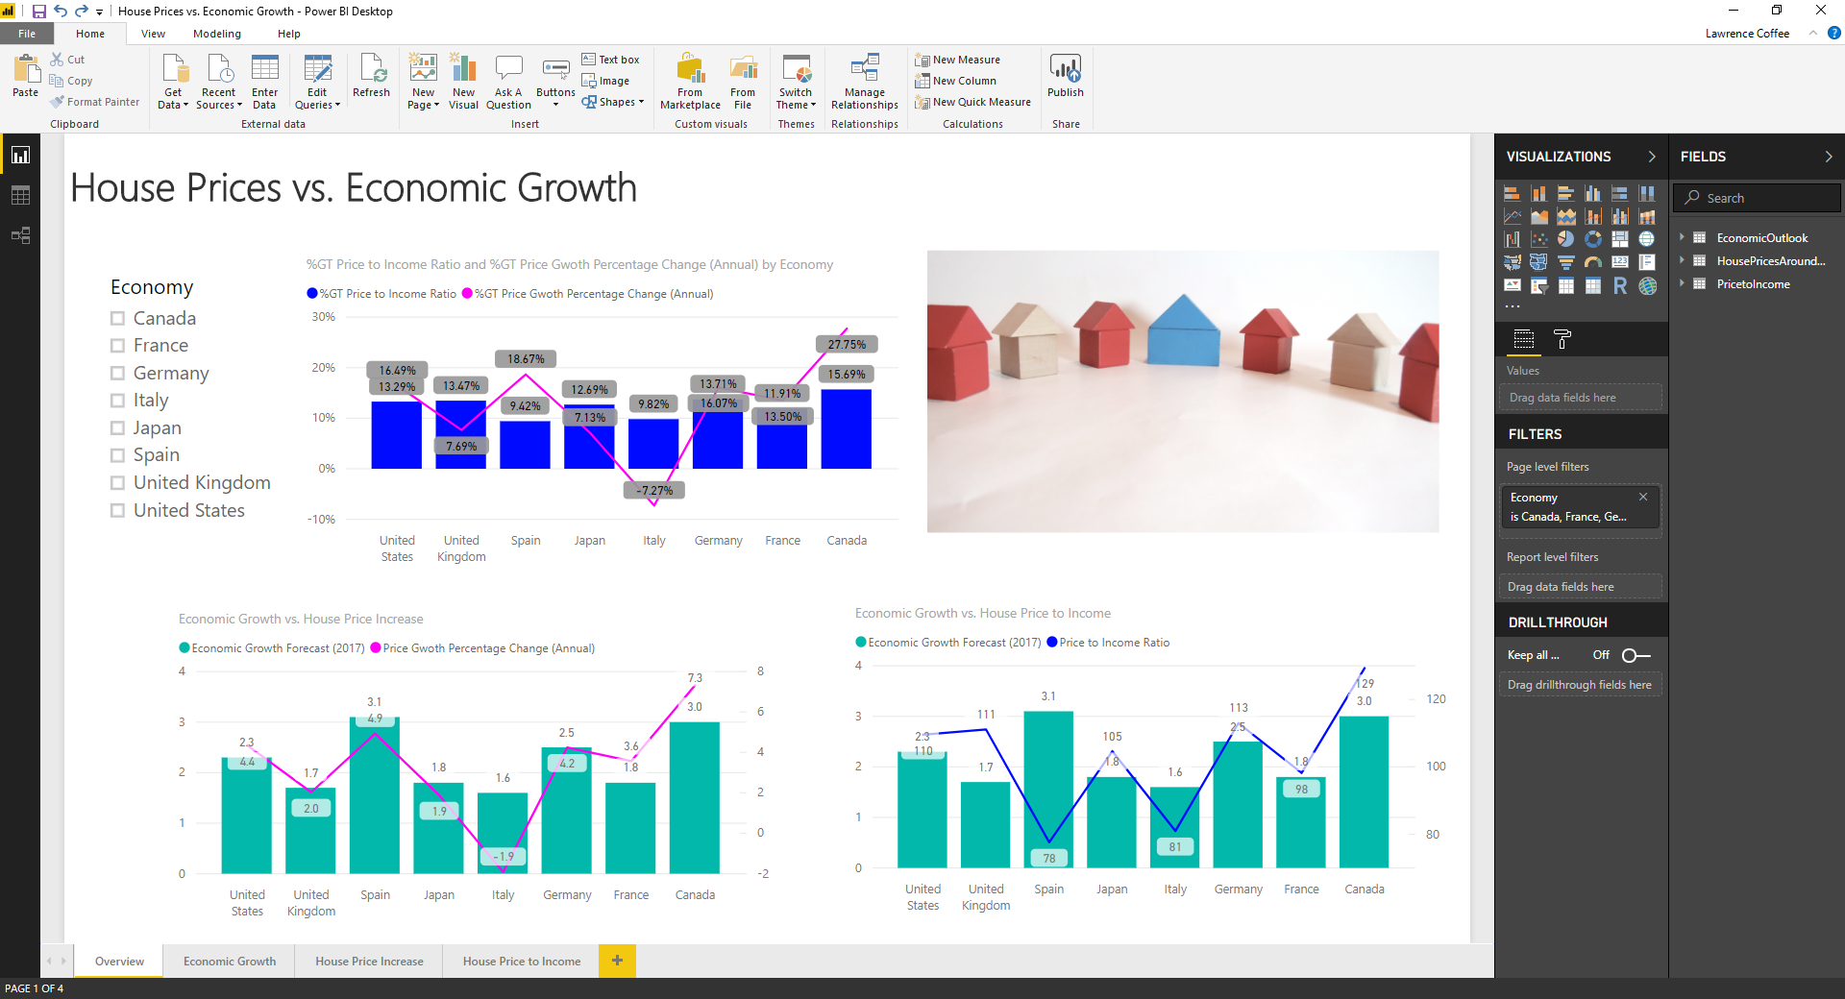
Power BI Desktop - User Interface (Report View)
Visualizations
Account Sign-In
Ribbon
Report
Data
Relationships
Data Model Views
CANVAS
Fields Pane
(Data Model)
Visualization
Controls & Formatting
Canvas Pages

Slide 7
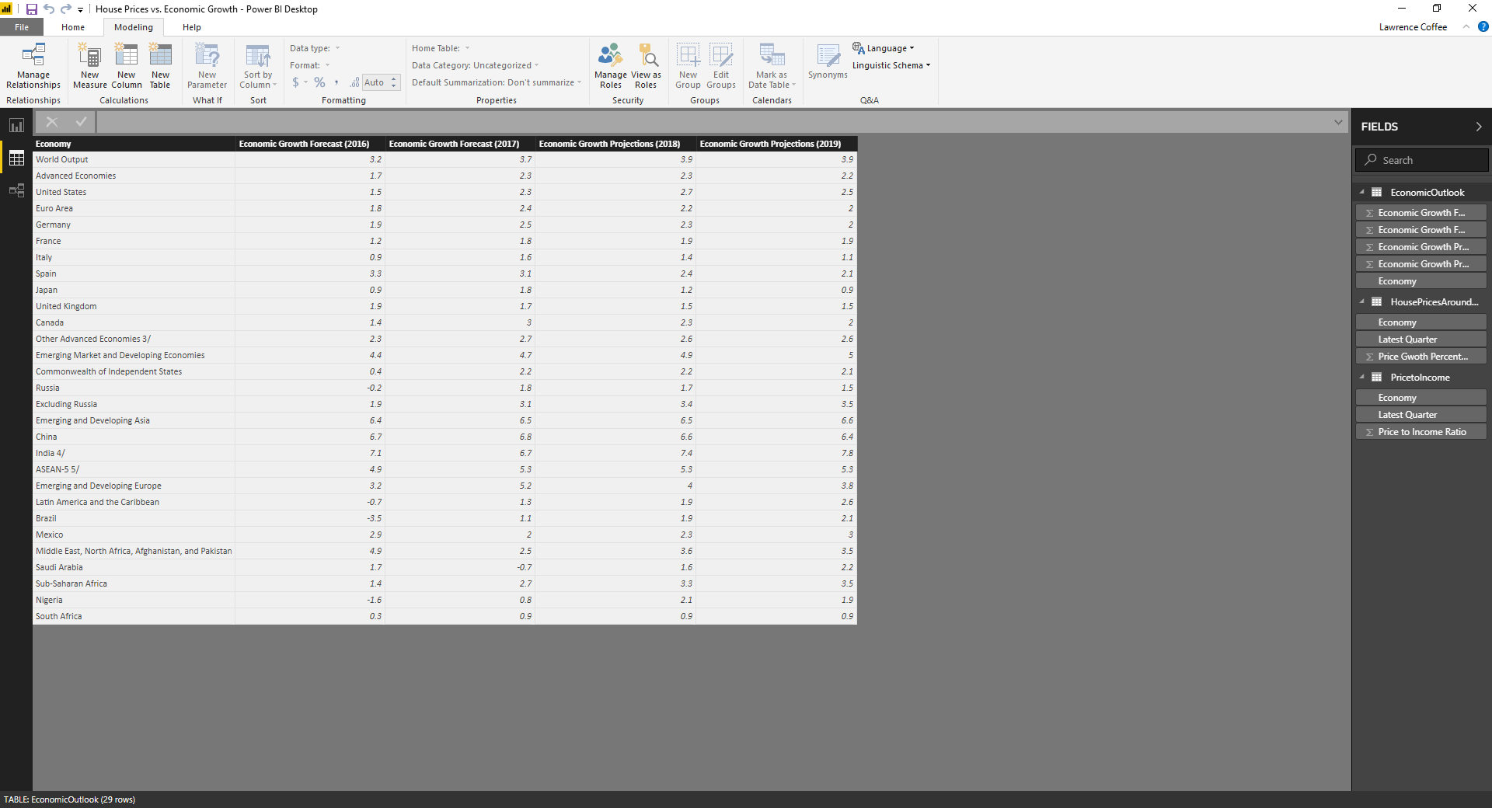
Power BI Desktop - User Interface (Data View)
DAX Calculations

Slide 8
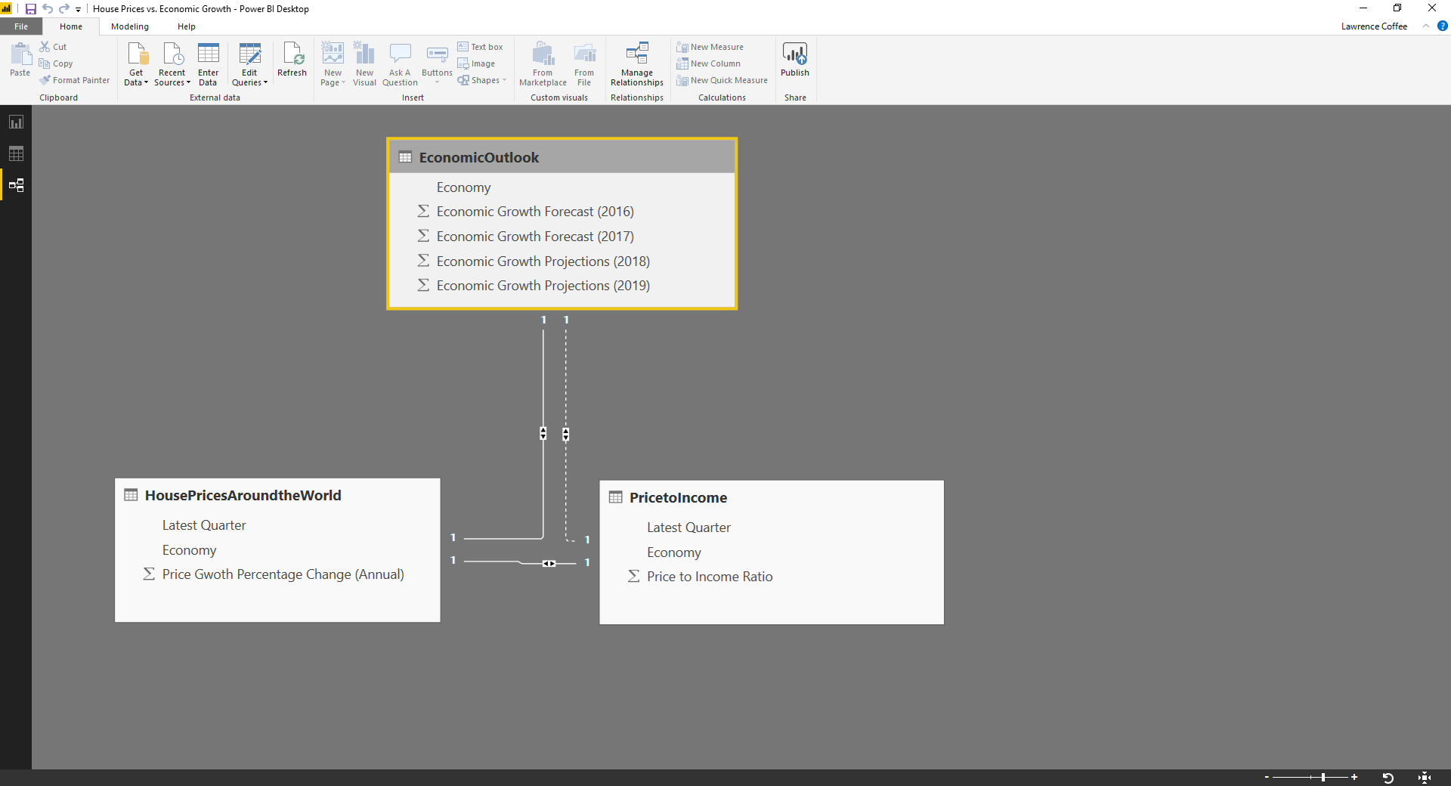
Power BI Desktop - User Interface (Relationship View)
Objects
Select to manage Relationships
Relationships

Slide 9
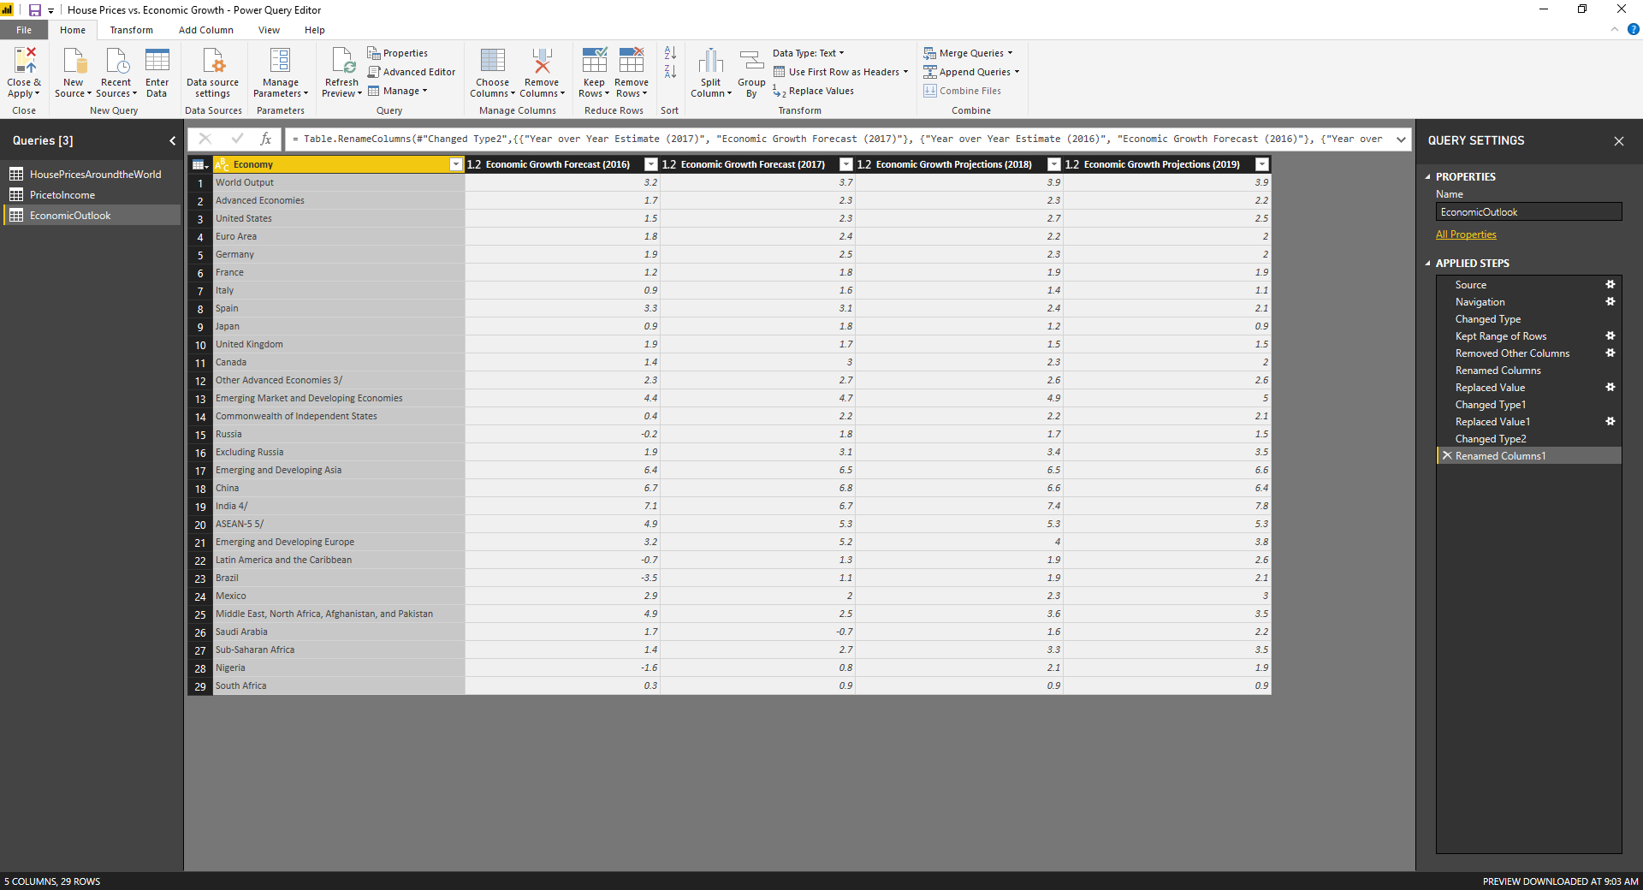
Power BI Desktop - Power Query Editor
Query Settings
Navigator Pane

Slide 10
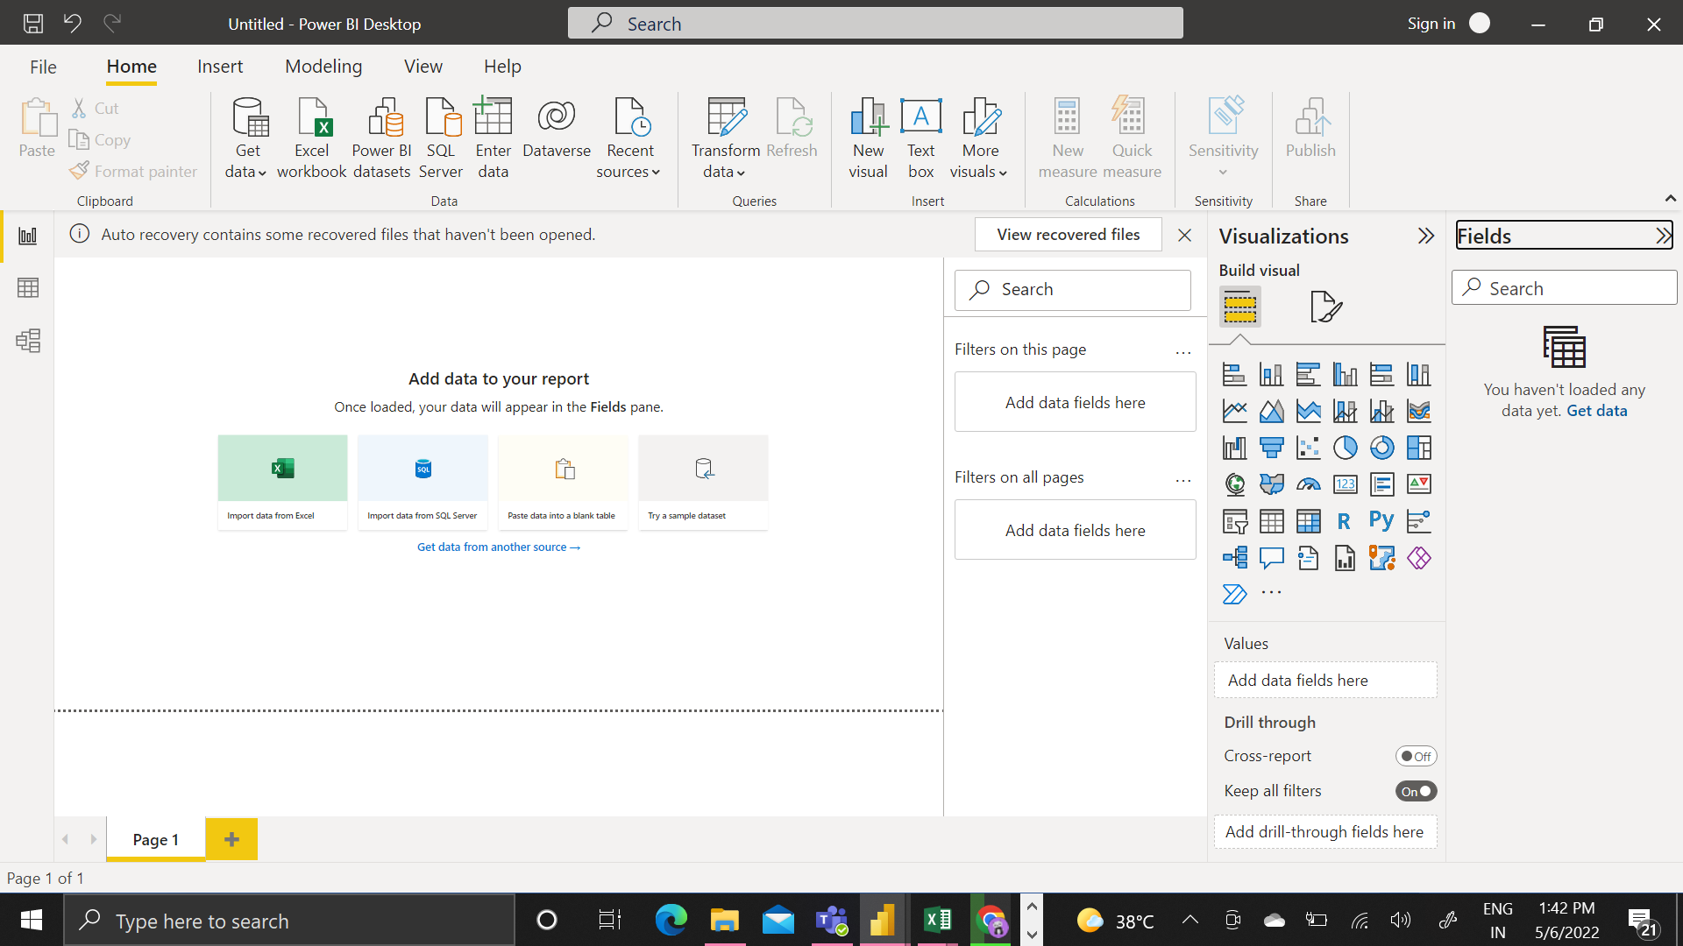
DEMO PROJECT 1 (ZOMATO RESTAURANT DATA ANALYSIS)
STEP-1) Signup,Download,Install & Configure

Slide 11
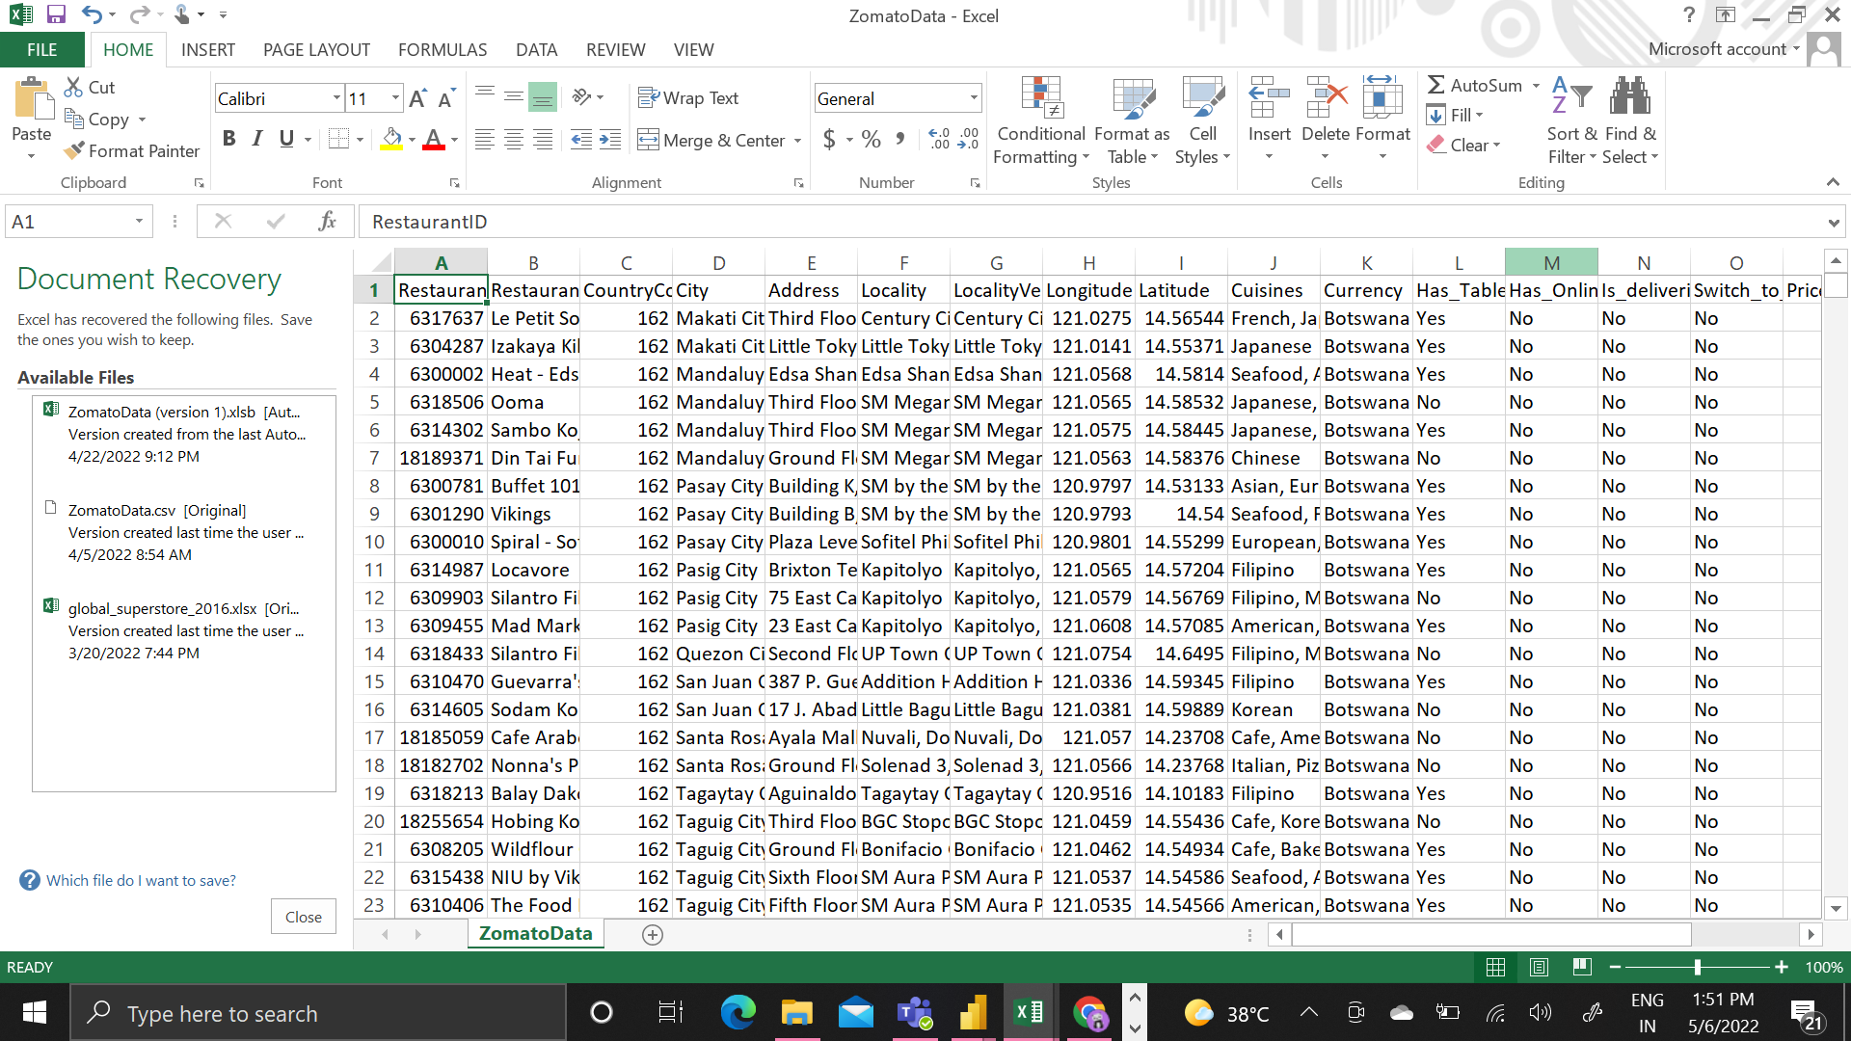
STEP-2 Get Data/Transform

Slide 12
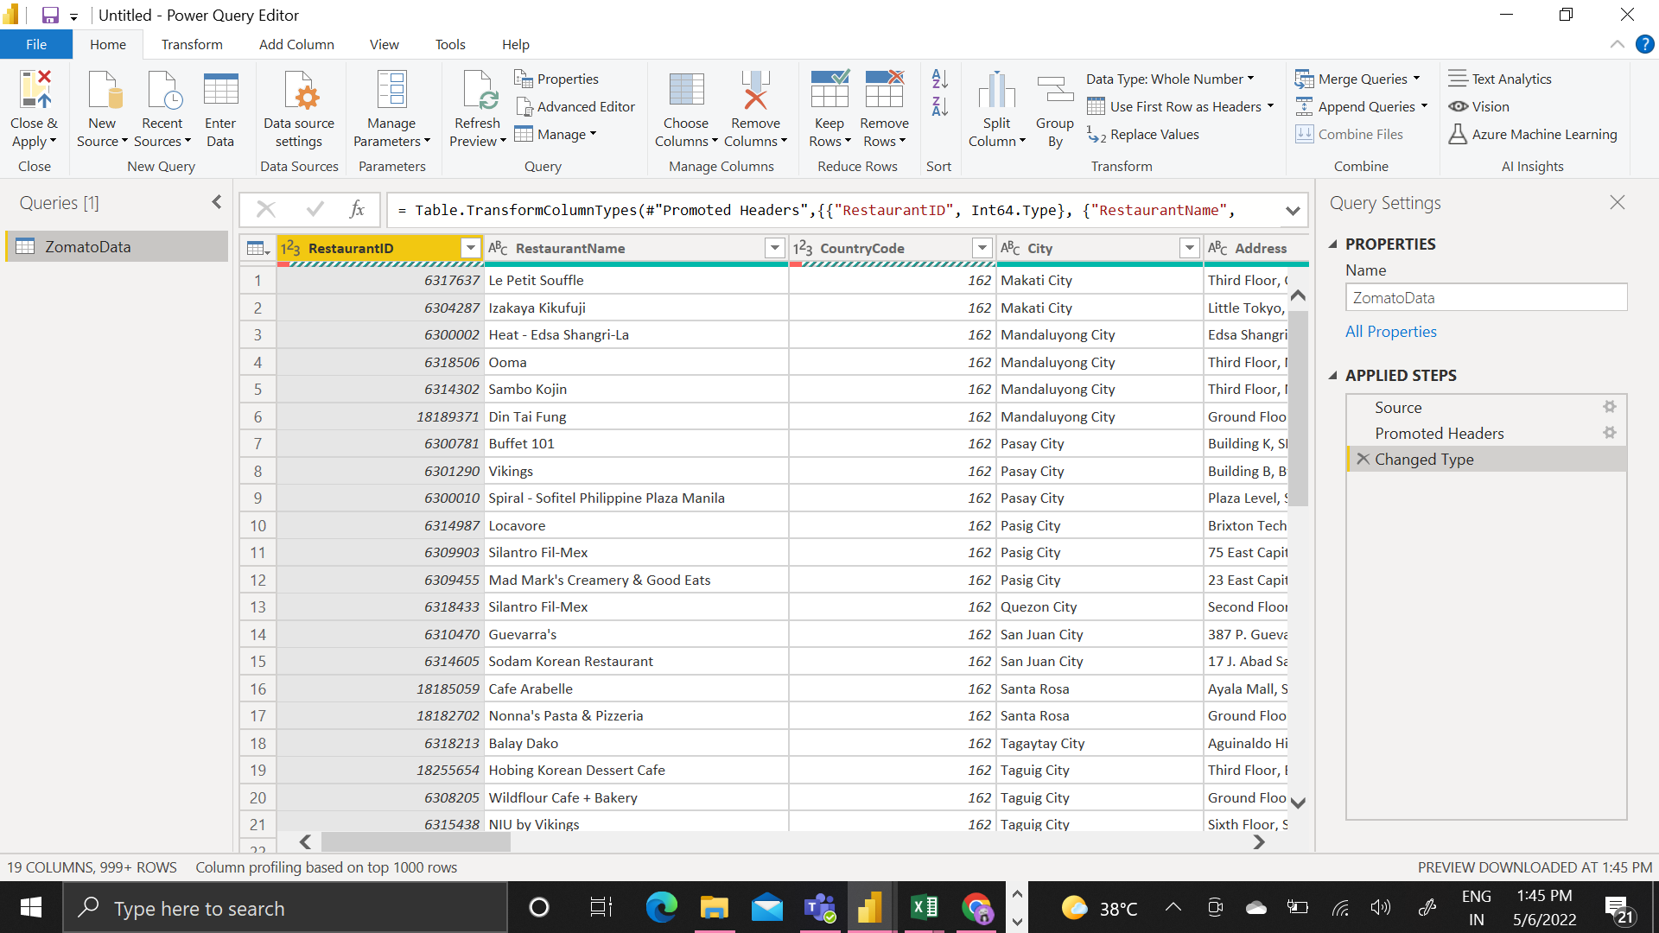

Slide 13
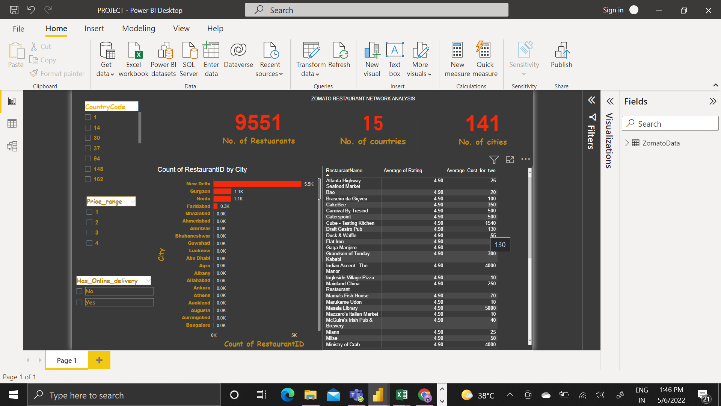
STEP 3 Create Model/Report and Share(RESPONSIVE SCREEN)

Slide 14
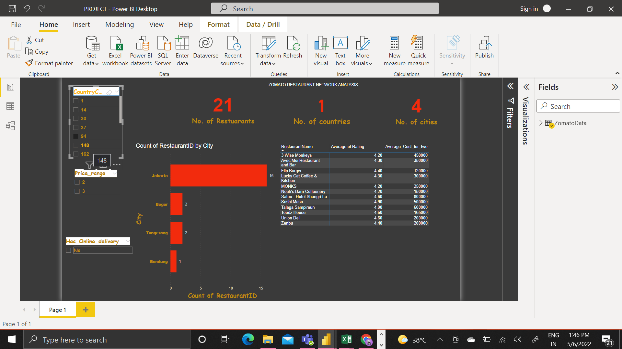

Slide 15
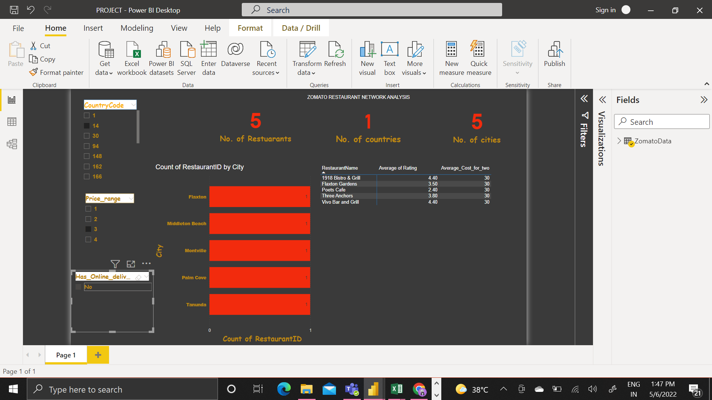

Slide 16
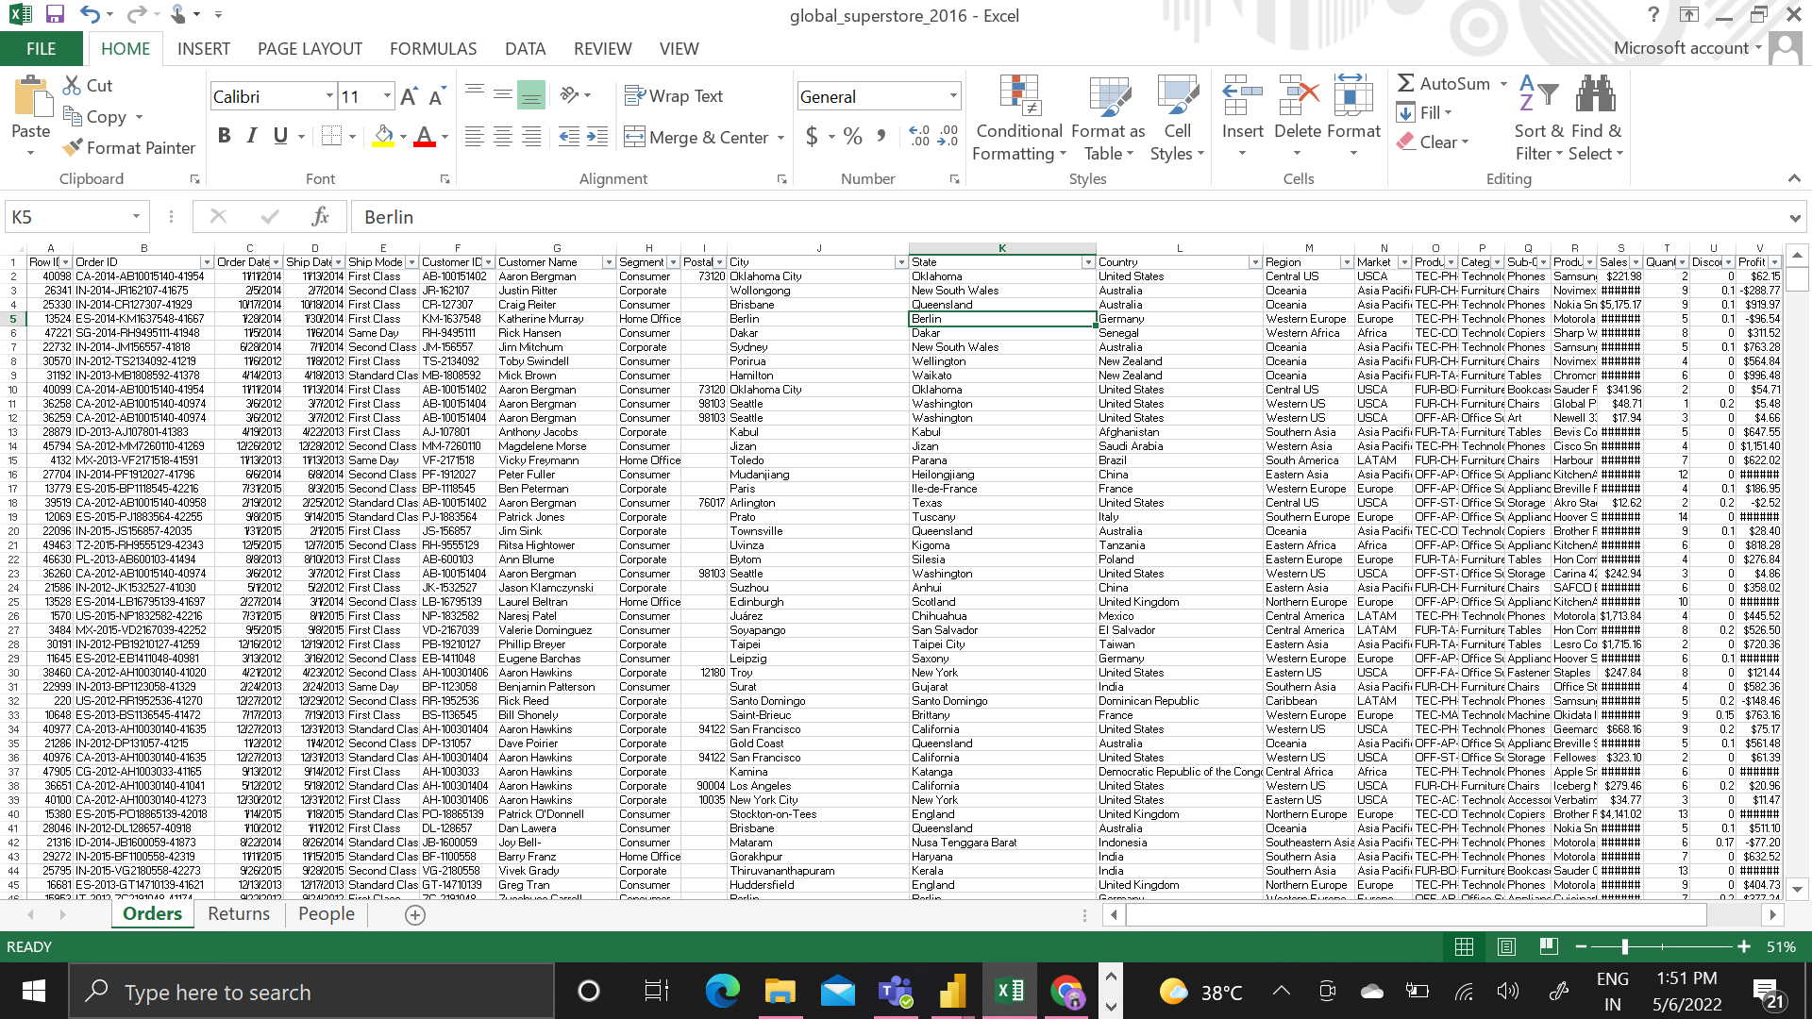
DEMO 2 –( GLOBAL SUPER STORE MARKET ANANLYSIS)

Slide 17
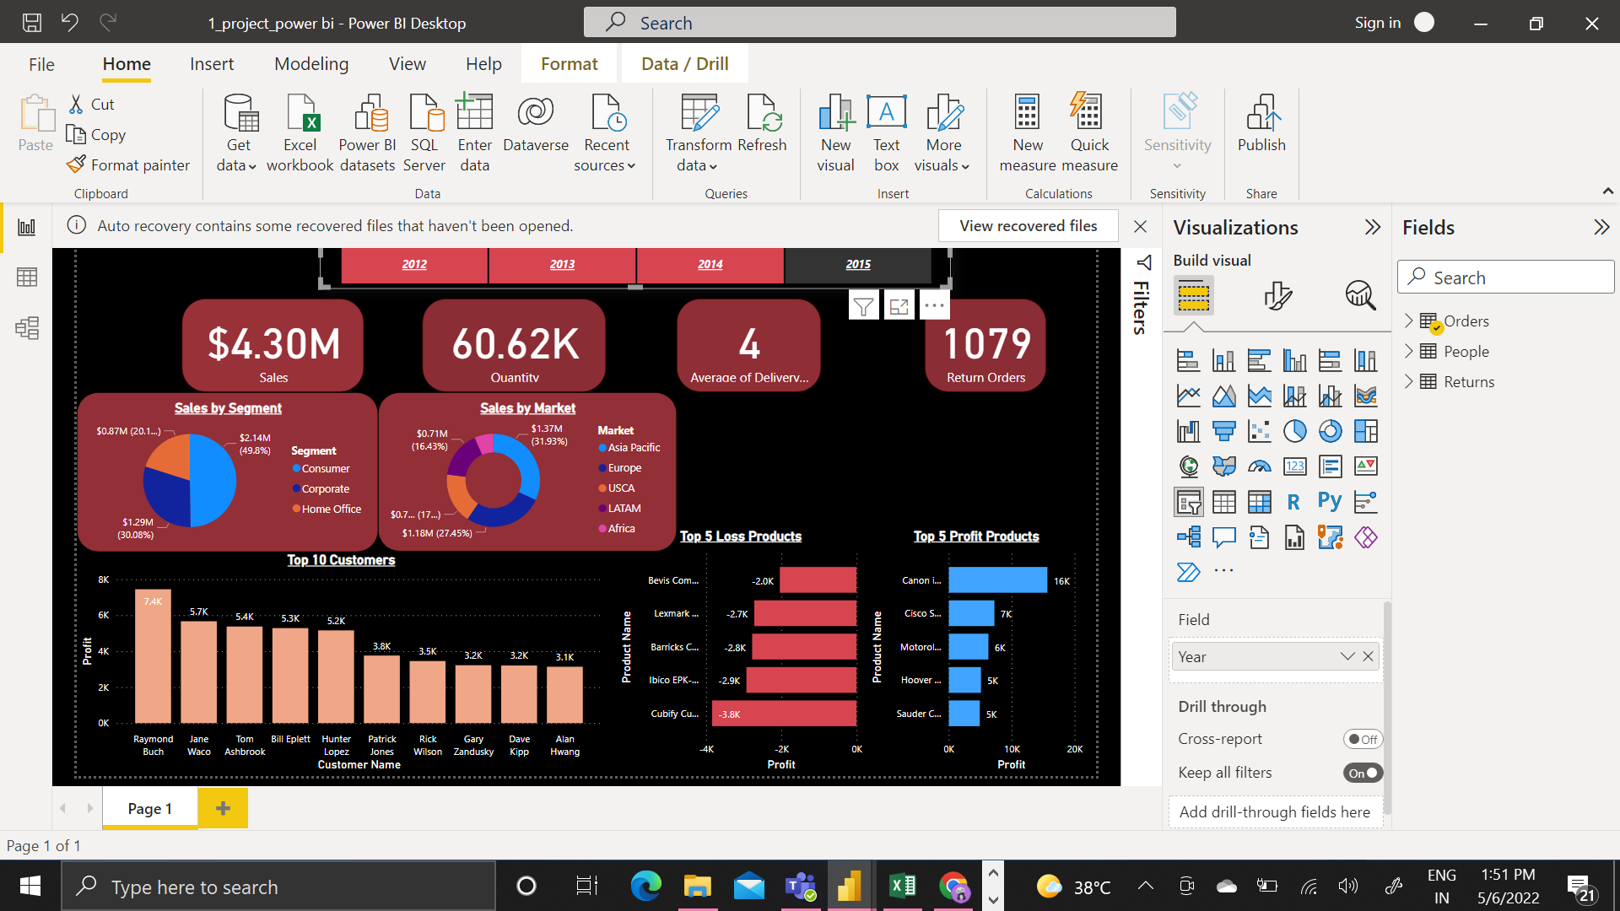

Slide 18
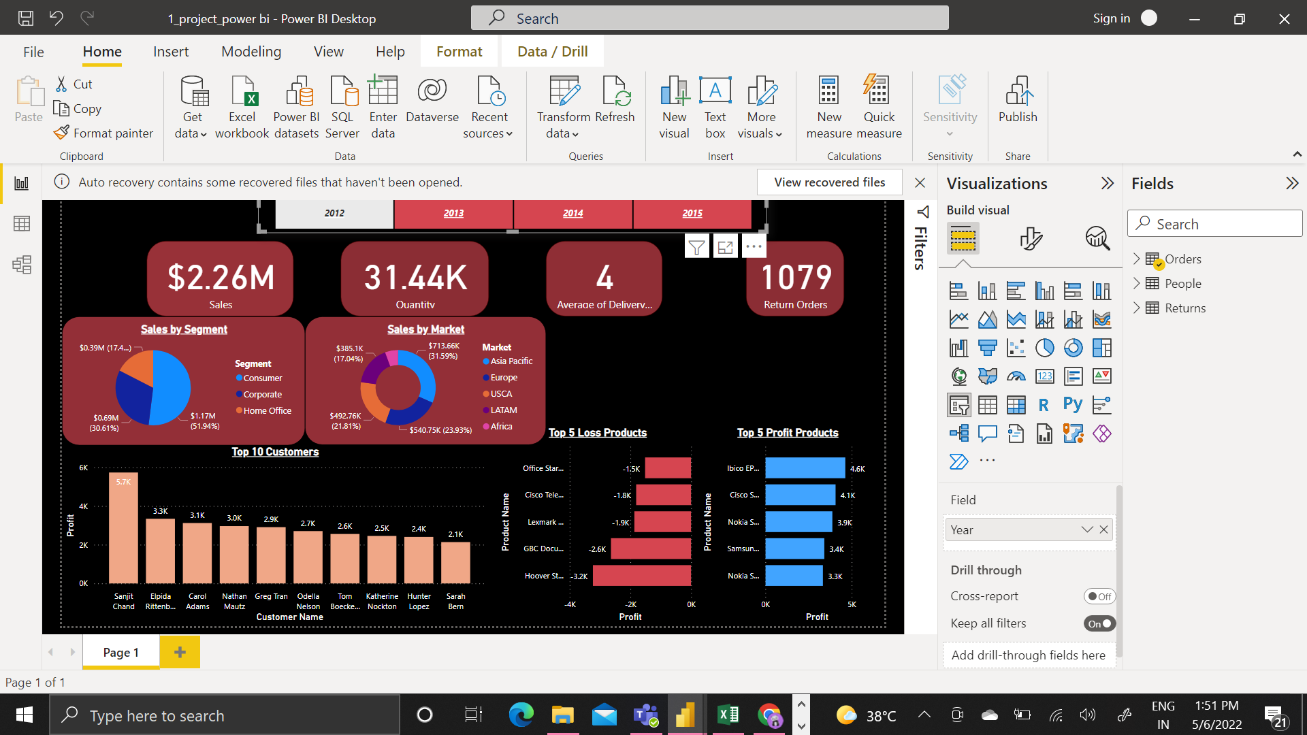

Slide 19
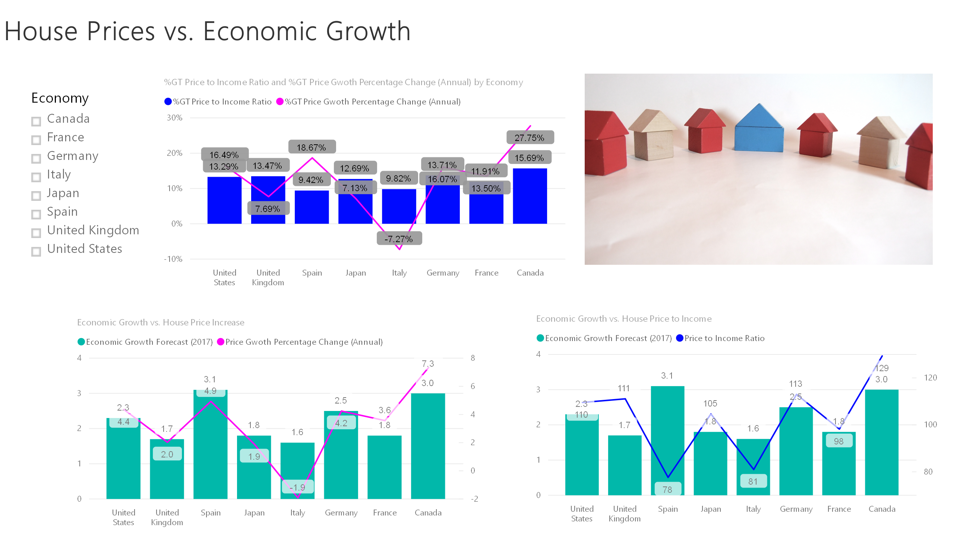
Slide A

Slide 20
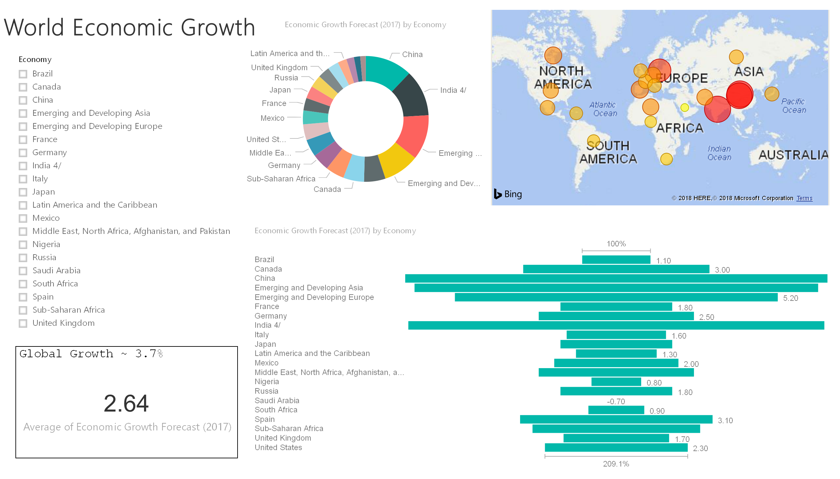
Slide B

Slide 21
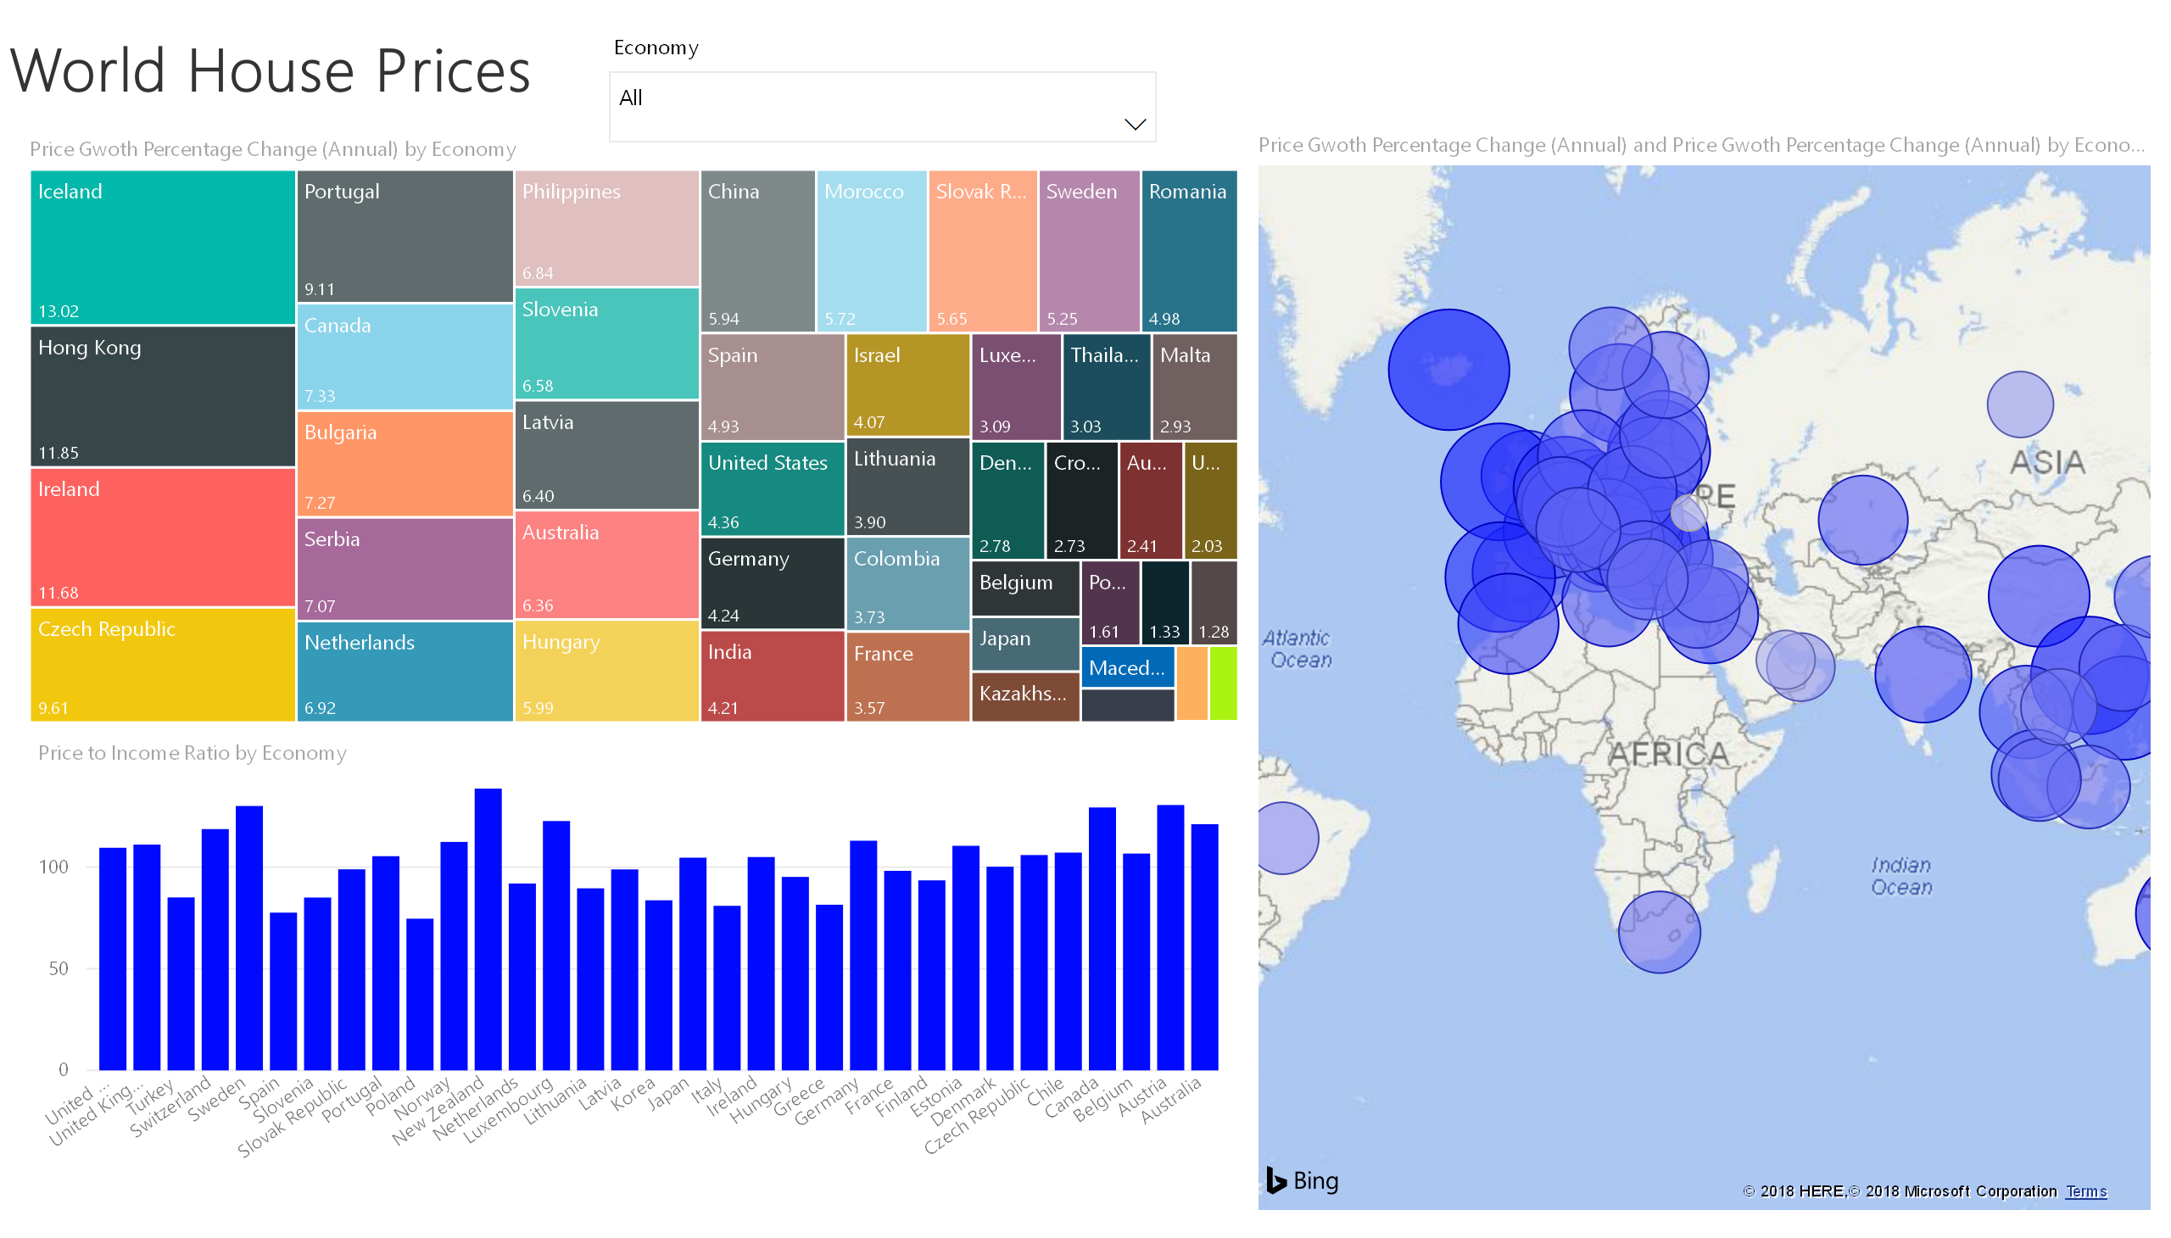
Slide C

Slide 22
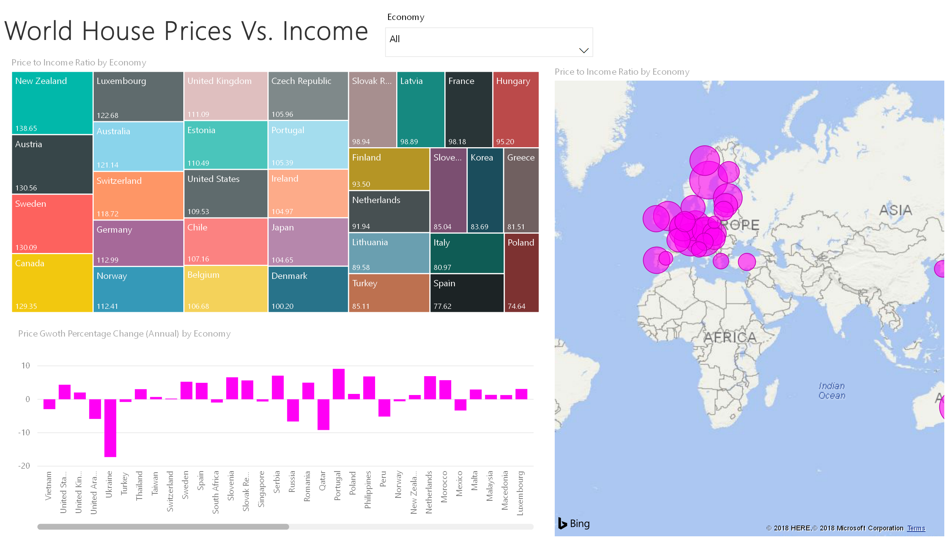
Slide D

Slide 23

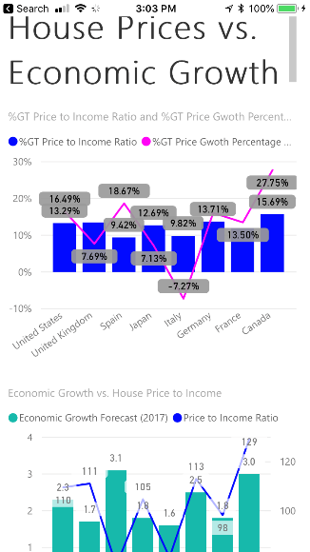
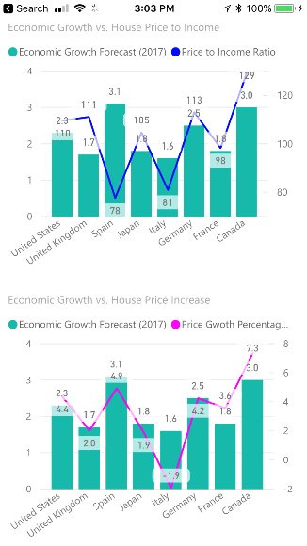

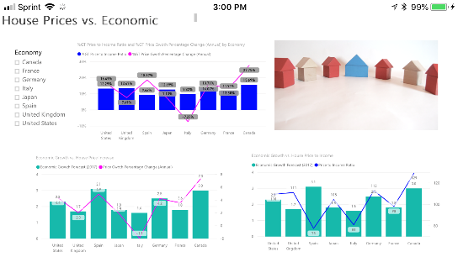
Mobile Views of Report

Slide 24
End Use Case
End Use Case

